Slide 1

Help travelers find their perfect choice with the least possible efforts

Slide 2

Designed By
Tushar Sohal
Shivam Thakran
Deepanshu Tomar
Sushant Kumar Jha

Slide 3
SUMMARY
Ghumakad is an Indian online travel company , it provides online travel services including domestic and international holiday packages, hotel reservations, car and bike rentals. It is a B2C business model that is business to customer directly without any middlemen. We offer discounts packages.. and pickup drop facility also

Slide 4
OBJECTIVE OF THE WEBSITE
Travel and tourism guides.
Digital version of a traditional guide book, aiming to provide advice on which destinations, attractions, accommodations, and so on, are worth a visit and providing information on how to access them.
Help travelers find their perfect choice with the least possible efforts.

Slide 5
SOFTWARE REQUIREMENT
HTML : HTML stands for Hyper Text Markup Language. It is the standard markup language for creating Web pages . It describes the structure of a Web page . It consists of a series of elements. HTML elements tell the browser how to display the content . HTML elements label pieces of content such as "this is a heading", "this is a paragraph", "this is a link", etc.

Slide 6
CSS : CSS stands for Cascading Style Sheets. It describes how HTML elements are to be displayed on screen, paper, or in other media. It saves a lot of work. It can control the layout of multiple web pages all at once . External style sheets are stored in CSS files.
Bootstrap: Bootstrap is an HTML, CSS & JS Library that focuses on simplifying the development of informative web pages (as opposed to web apps). The primary purpose of adding it to a web project is to apply Bootstrap's choices of color, size, font and layout to that project.

Slide 7

JavaScript : JavaScript is a text-based programming language used both on the client-side and server-side that allows you to make web pages interactive. Where HTML and CSS are languages that give structure and style to web pages, JavaScript gives web pages interactive elements that engage a user.

Slide 8
PROJECT IDEA
Ghumakad is an Indian online travel company
Ghumakad provides online travel services including domestic and international holiday packages, hotel reservations, car and bike rentals.
Ghumakad is a B2C business model that is business to customer directly without any middlemen and offer’s discounts packages.. and pickup drop facility .

Slide 9
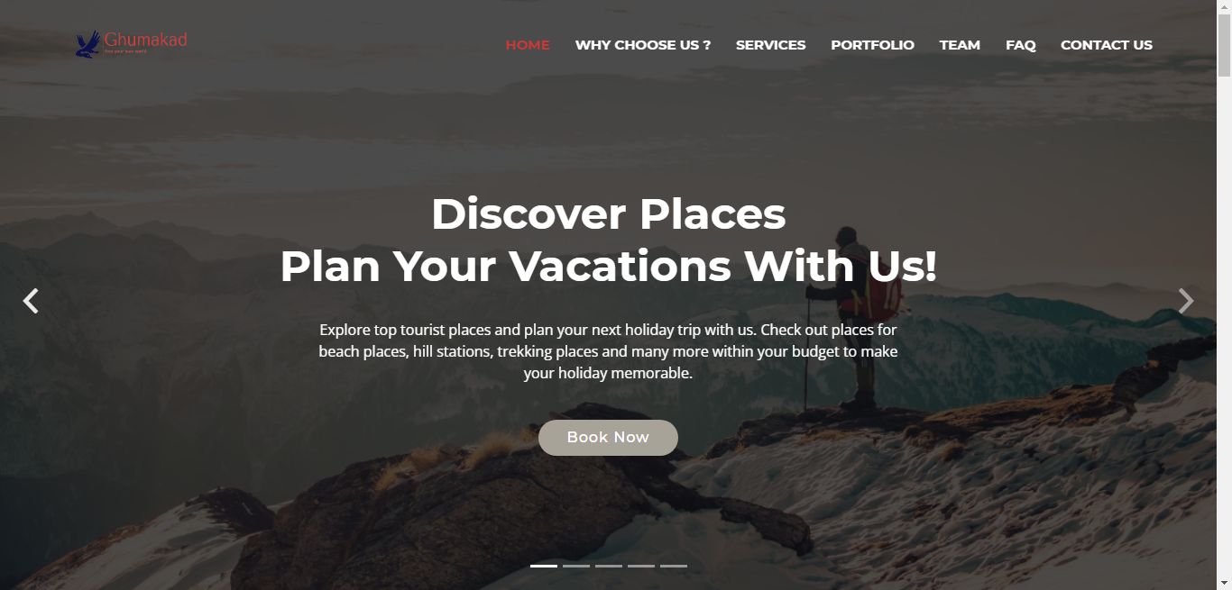

Slide 10
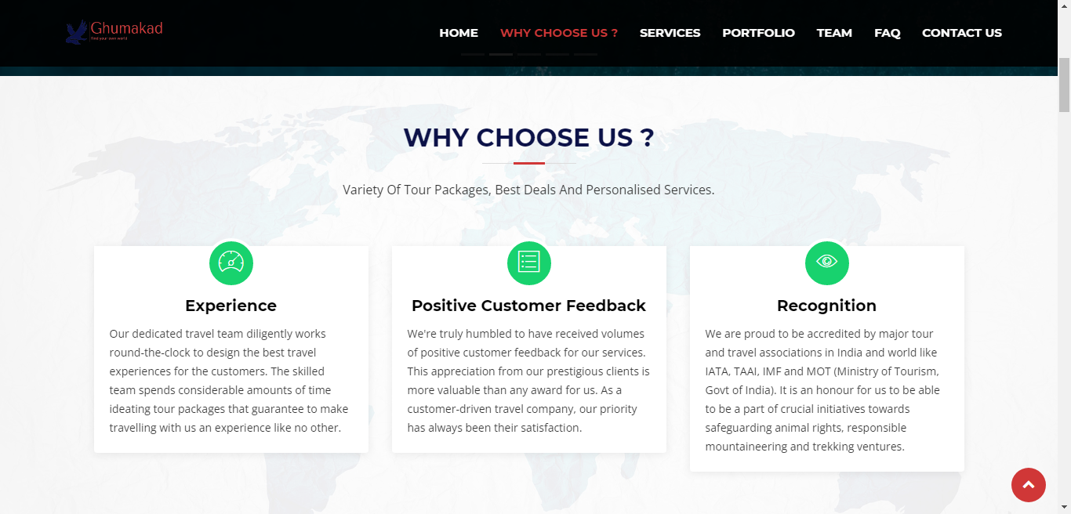

Slide 11
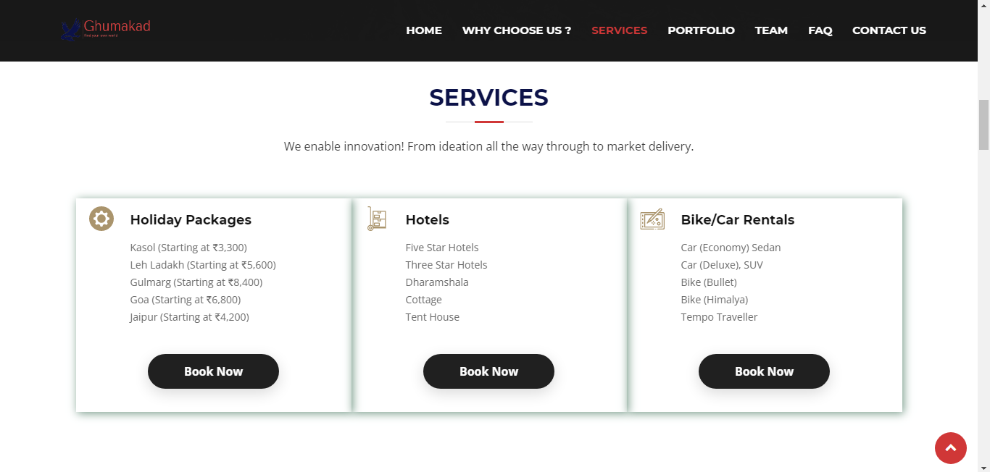

Slide 12
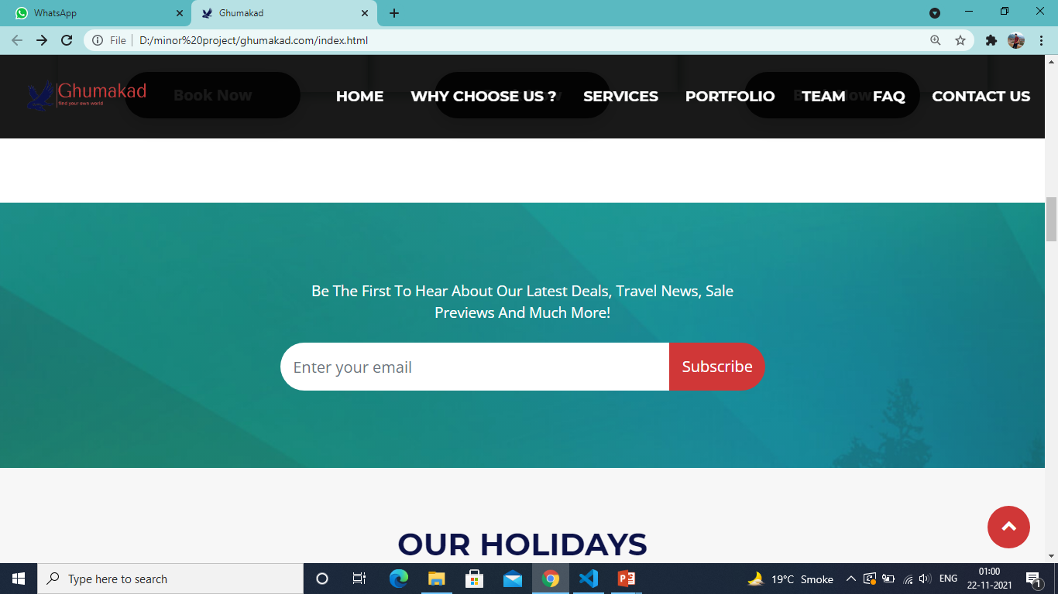

Slide 13
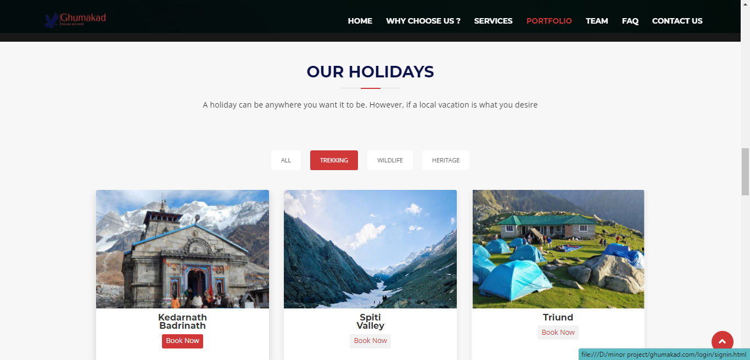

Slide 14
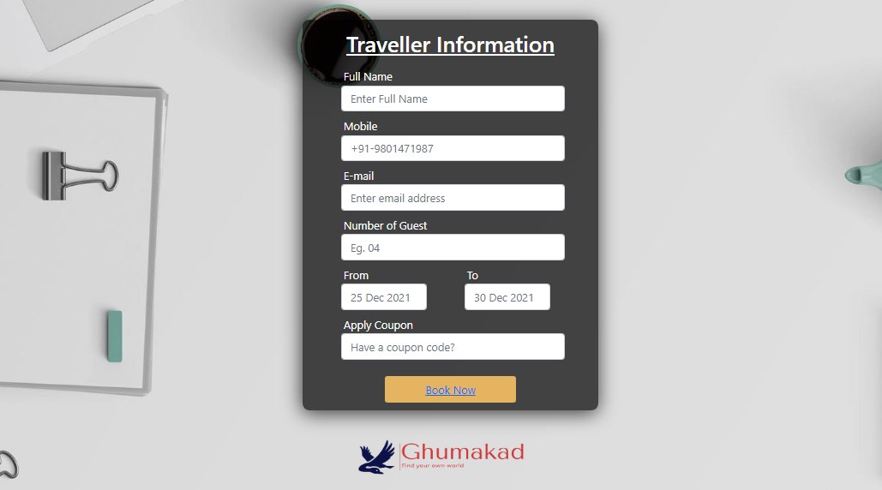

Slide 15
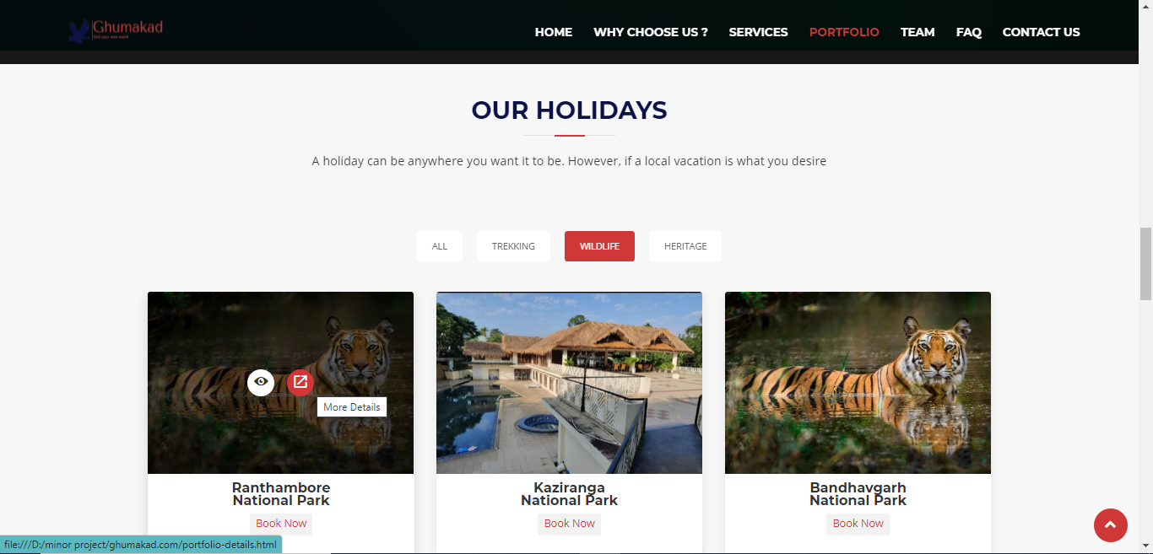

Slide 16
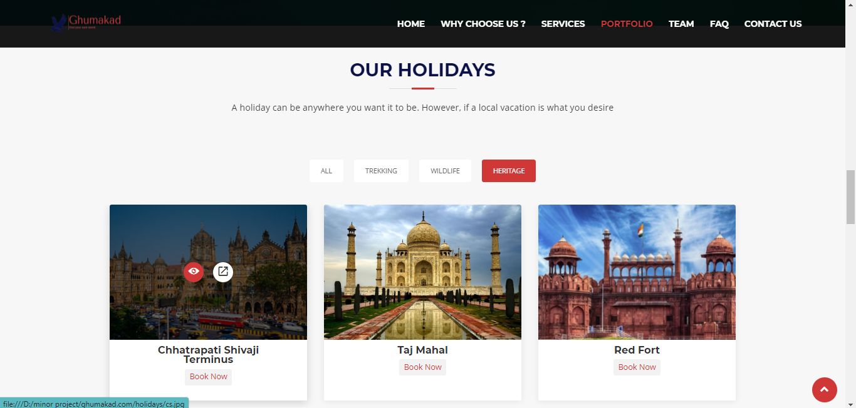

Slide 17
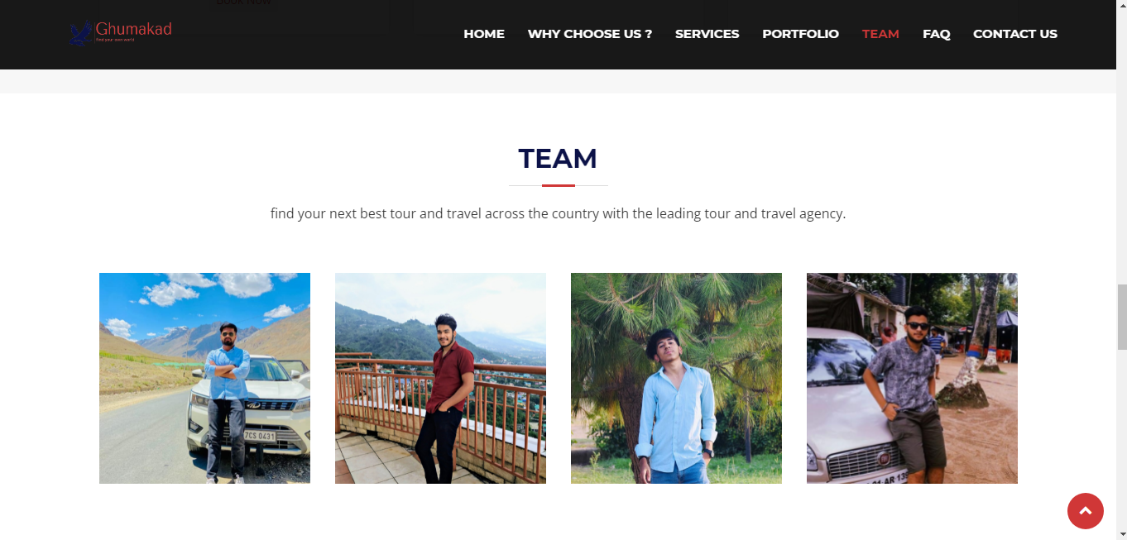

Slide 18
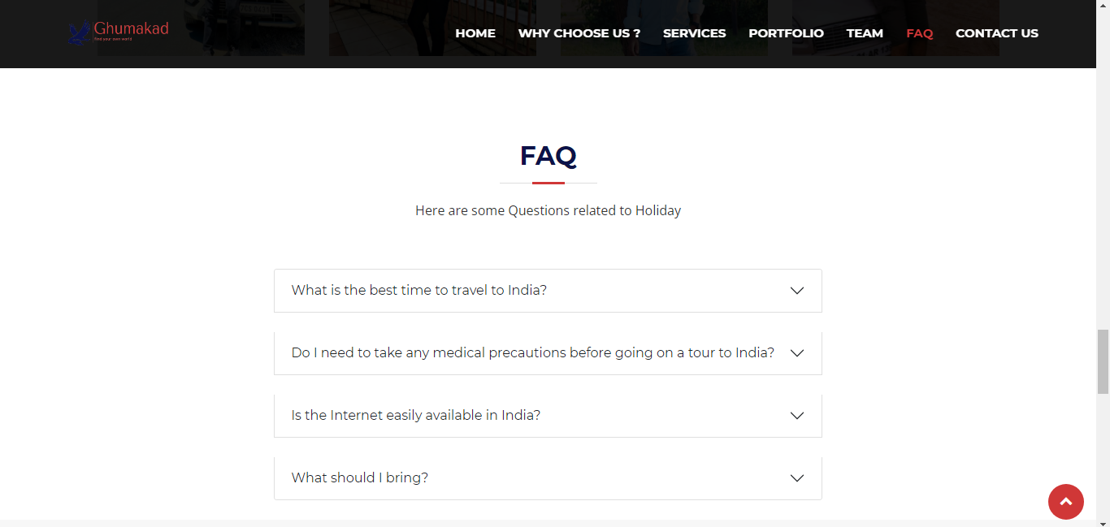

Slide 19
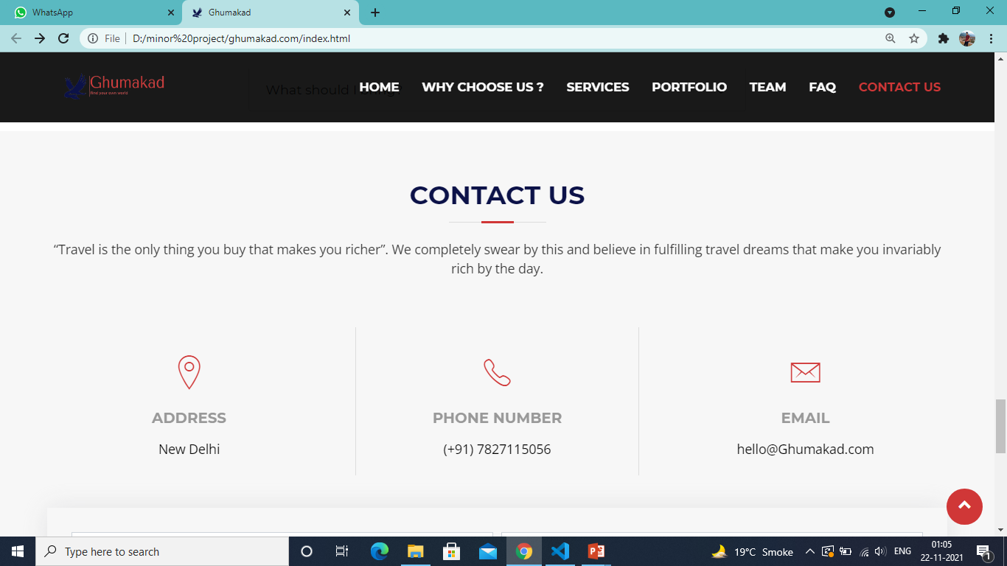

Slide 20
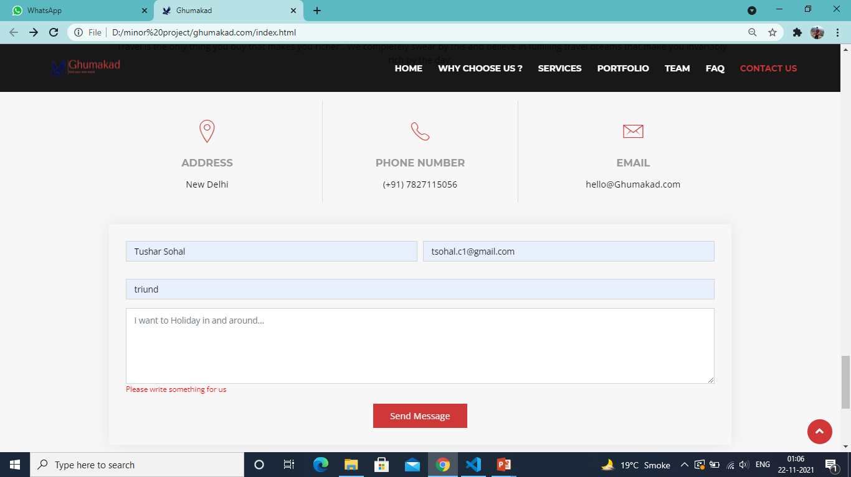

Slide 21
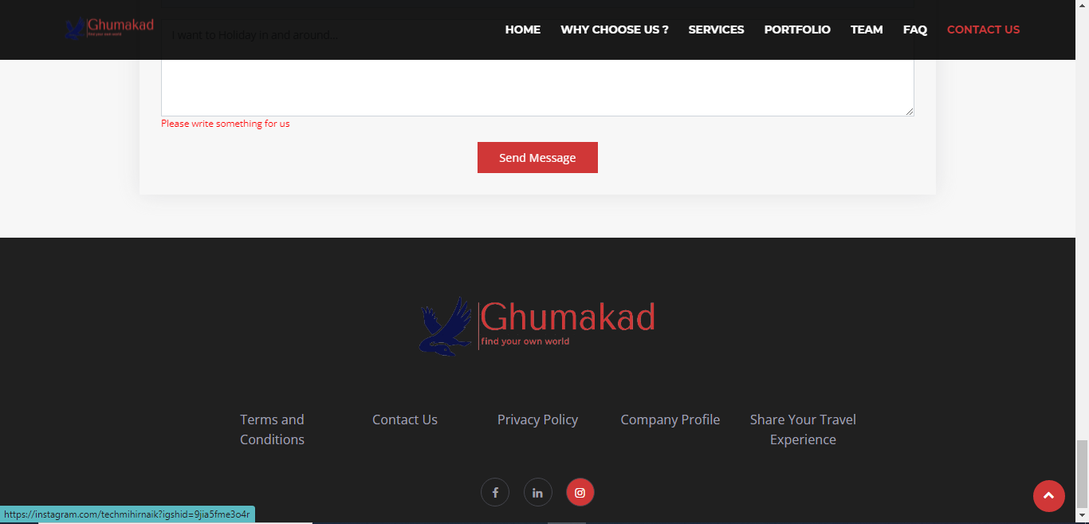

Slide 22


